Slide 1
Sentence processing
Ho do we make sense of sentences?
How structural computation creates meaning?
Does meaning affect structural computation?
Is parsing autonomous?
Why some sentences are ambiguous?
How do we recover from ambiguity?
Serial vs parallel processing
Behavioral and neural data

Slide 2
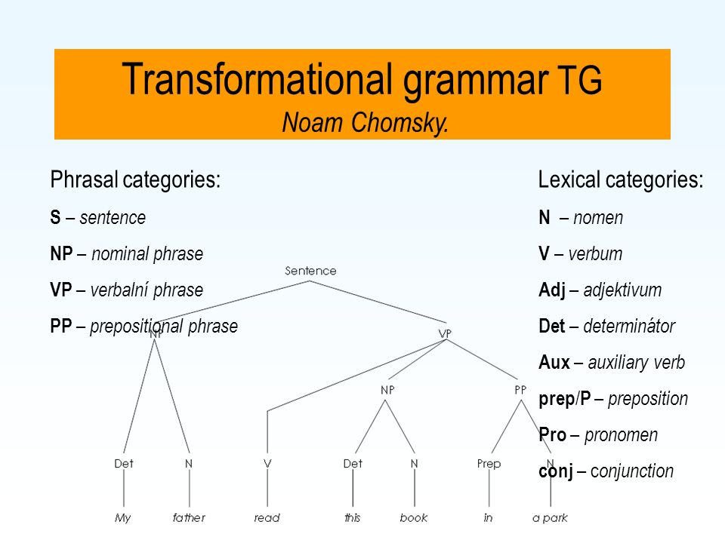

Slide 3
Computation
Sentence processing is computation
Computation is rule based
Is this deterministic or probabilistic?
Chomsky’s approach is deterministic
Semantics plays no role we can still understand completely meaningless sentences that are otherwise syntactically well formed

Slide 4
What is the goal of studying sentence processing
Psychological reality of sentence parsing
WM, attention, vision, perception
Modeling parsing
A general theory of mental computation

Slide 5

General goal was “to discover how people understand language”
Many studies showed that people had problem understanding some sentences (if they are presented visually without punctuation):
While Anna dressed the baby spit up on the bed.
The baby is the object of dressed
When they encounter spit up => error

Slide 6
Global ambiguity
Someone shot the servant of the actress who was on the balcony
The cop chased the criminal with a fast car

Slide 7
Ambiguity
Lexical
Semantic
structural

Slide 8
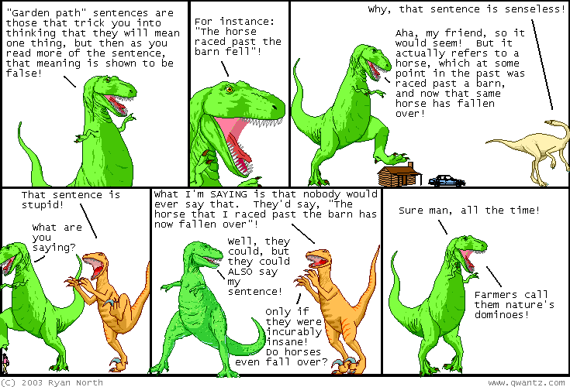
Garden path theory
The horse raced passed the barn fell

Slide 9
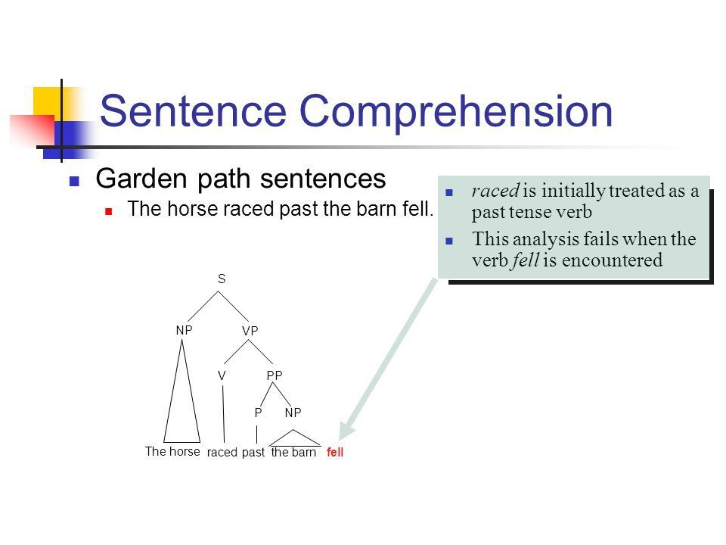

Slide 10
Processing stretegy
Minimal attachment ( Parser builds the simplest structure)
Late closure ( upcoming phrases are integrated)
(John said) (he would leave yesterday)
John said (he would leave) yesterday

Slide 11
Syntactic ambiguity
(early/late closure)
The criminal shot
the servant of the actress who was on the balcony
Who was on the balcony?
the servant
?
the actress
early closure
late closure
dominates in Russian
dominates in English

Slide 12
Models of reanalysis
Goal of all models of reanalysis is to
describe and motivate the mechanisms
used by the parser to detect errors,
deduce useful information about the
nature of the necessary repair from those
errors, and ultimately to create successful
parse.
Is reanalysis always successful? – No
=>
Another goal of models of reanalysis is to
explain why it is that successful revision is
possible for some sentences but impossible
for others.

Slide 13
What does influence the ease of reanalysis?
Ferreira & Henderson (1991, 1998) =>
While Anna dressed the baby that was small and cute spit up on the bed.
the error signal the head of the misanalysed phrase
Reanalysis is more difficult if the head of the misanalysed phrase is distant from the error signal! However, the length of the sentence is not important.

